Slide 1

Introduction to Jenkins
Module 1: CI/CD Overview

Slide 2
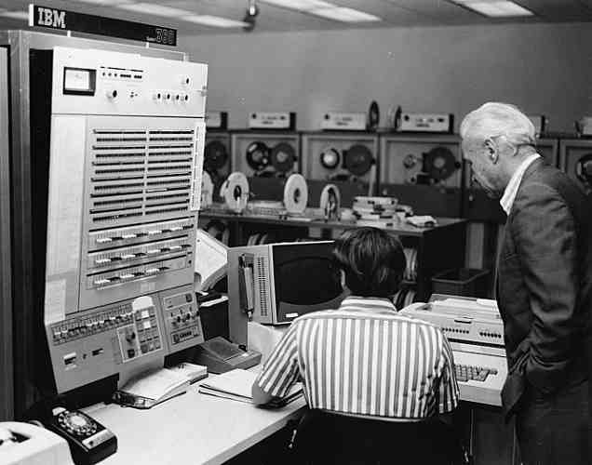
Software Development
Software development has gone through a series of evolutionary steps
1950s – 1980s
  Dominated by mainframes
  Batch programming and procedural languages
  Monolithic applications
  Software development was usually a series of manual steps
  Applications were relatively small in terms of the amount of code

Slide 3
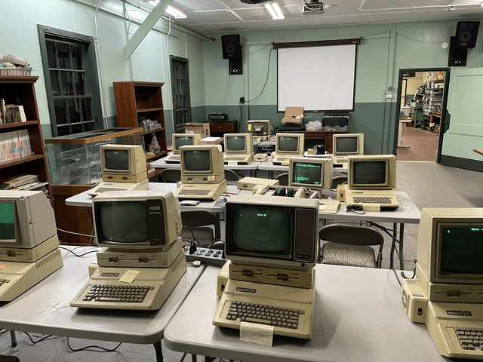
Software Development
1990s – 2010s
  Cheaper hardware allowed distributed computing
  Networking and Internet based applications started to be developed and deployed
  Real time and Object-Oriented programming went mainstream
  Adoption of virtualization to make more effective use of hardware
  Business drivers
    Be more responsive to market and customers
    Reduce delivery times
    Be able to scale operations and code base
  Agile methodologies and automation tools become important for developers in responding to business drivers

Slide 4
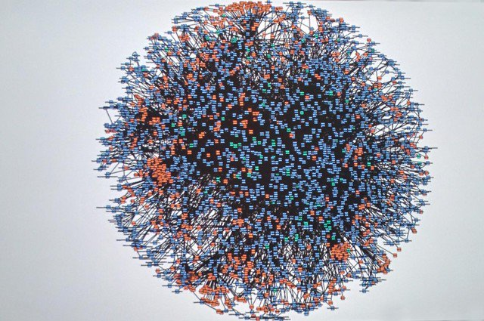
Software Development
2010s – Now
  Massive increases in the complexity of application and operational codebase
    Petabytes of streaming data
    Billions of transactions
    Mission critical fault tolerance
  Rise of microservices
    Results in a “Death Star” architecture
    Not manageable by previous operations techniques
    Image: Amazon in 2008 – each node represents a running code module
  DevOps becomes mainstream
    Infrastructure as code (IaC) to support virtualization
    Automation support through the development and deployment lifecycle
  Pipelines and automation tools are required for these large and complex applications

Slide 5
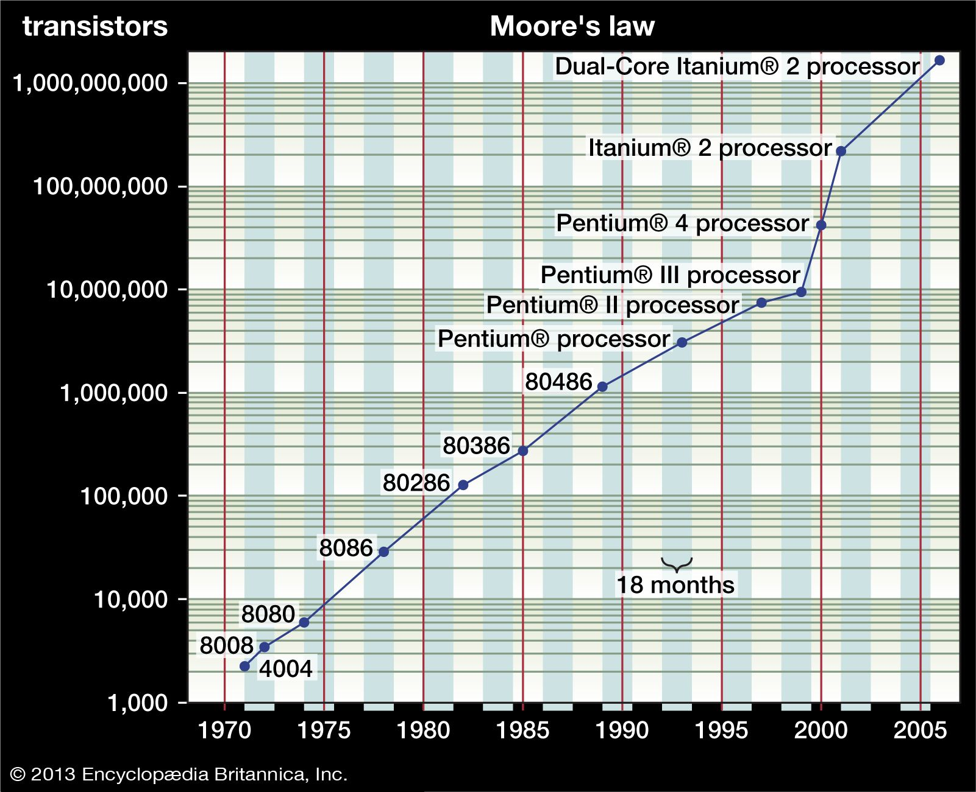
Moore’s Law
Historically, advances in hardware capabilities tend to be exponential.
  Coupled with similar decrease in costs
This is referred to as Moore’s law
  Originally formulated as a measure of the amount of computation power of a chip in terms of “transistors”
  The original formulation is no longer valid because of changes in chip and CPU architecture
  But the term Moore’s law is now generally used to describe increasing compute and storage capabilities coupled with dropping costs
Image Credit: https://www.britannica.com/technology/Moores-law

Slide 6
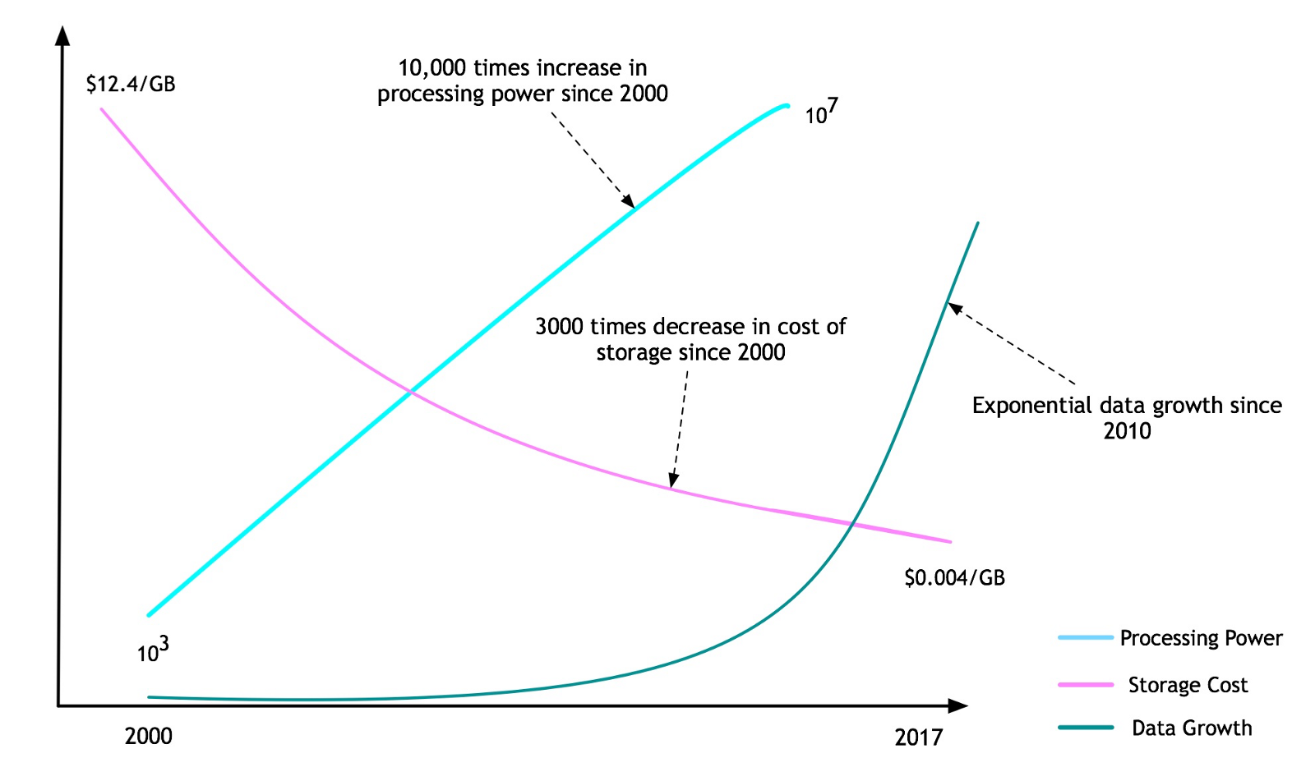
Hardware Capabilities
Image Credit: https://blog.govnet.co.uk/technology/reflection-on-the-maturity-of-bim-and-digital-twins

Slide 7
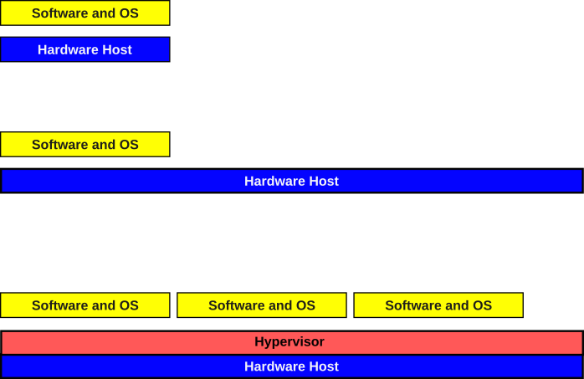
Hardware Outstrips Software
Historically, the limit of computing was hardware capabilities
  With the increases in hardware capabilities, the situation reversed
  The model of running and developing a single application in an OS running on a hardware platform didn’t scale well
Hardware capabilities were under utilized
  Adding virtualization allowed for multiple OS installations (VMs) to use the same hardware
  The problem became how to effectively utilize these new hardware capabilities

Slide 8
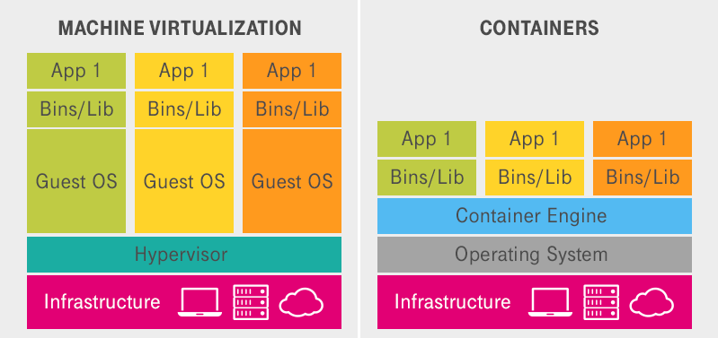
Containers
An alternative to VMs was development of Linux containers
  These allowed very lightweight self-contained applications to be independently deployed
  Like VMs, these are much smaller without the overhead of an OS and libraries
  Containers only contain what is necessary to run the application
  Containers don’t require infrastructure beyond the container engine
Image Credit: https://www.open-telekom-cloud.com/en/blog/cloud-computing/container-vs-vm

Slide 9
Microservices
Microservices are a software architectural pattern
  Enables software operations to use compute resources effectively and to operate in a more robust and reliable manner
  Focus is on issues around scaling in both the development and operations
Deploying microservices requires
  Supporting technologies in operational environments like Kubernetes, Kafka, Docker
  Analysis and design techniques for building a component based software architecture
  Code and application design techniques to make code “microservices ready”
  Production techniques to support the successful deployment of a microservice
An integral part of microservices development is the use of CI/CD

Slide 10
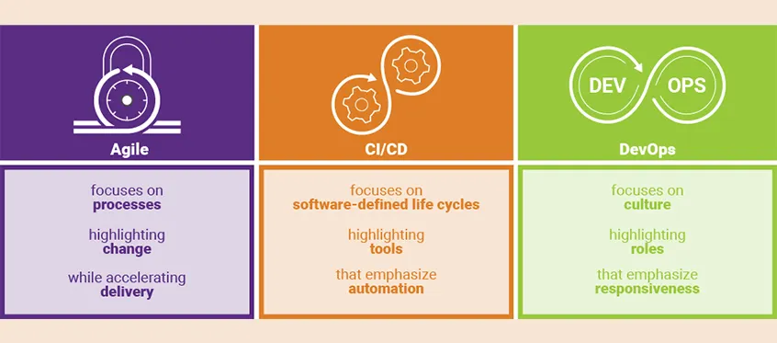
Agile – DevOps - CI/CD
Image Credit: https://medium.com/@vidhatanandV/achieving-value-with-progressive-delivery-438507cfbc6b

Slide 11
Infrastructure as Code
Virtual machines directed the hypervisor to allocate hardware from the host systems
  The host hardware was presented to the VM as virtual devices
  Allowed AWS and others to implement VMs and other virtual hardware “in the cloud”
    Referred to as “Infrastructure as a Service” (IaaS)
This meant that provisioning an operational environment
  Did not mean working with hardware directly
  Instead, a specification or set of instructions to the hypervisor is written in some IaC language
    For example, Terraform is one of the most commonly used tools for cloud infrastructure
  The spec tells the hypervisor what virtual hardware needs to be created and deployed
  The hypervisor does the hardware allocation that maps to the virtual device in the VM
This written description of the virtual environment is “infrastructure as code”

Slide 12
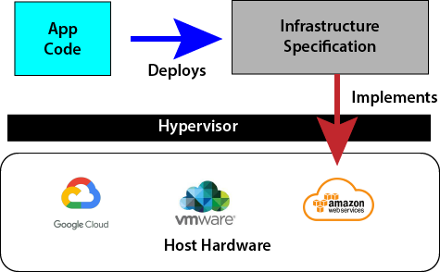
Infrastructure as Code

Slide 13
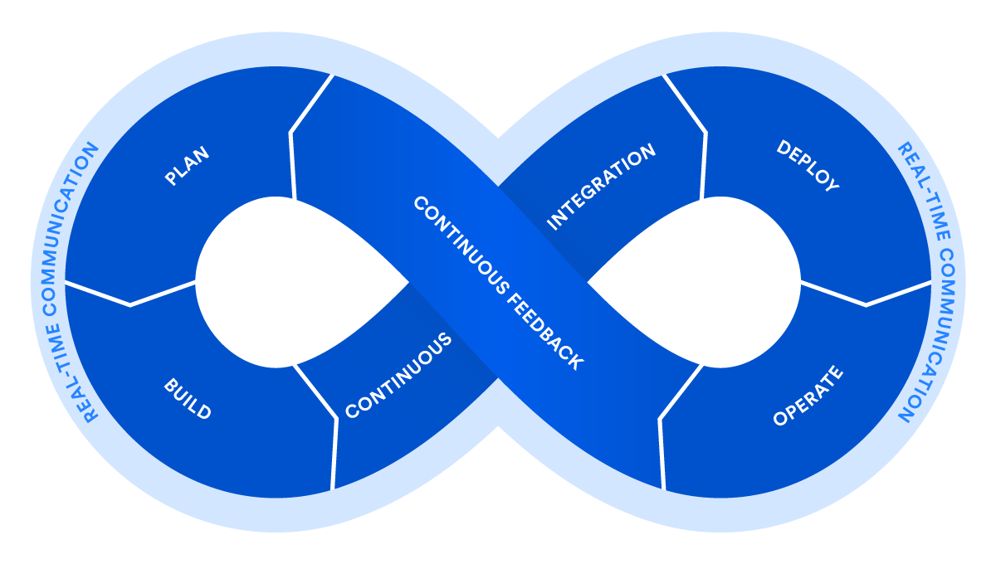
DevOps
Driven by virtualization and IaC
  Dev and Ops had been two separate worlds
  Dev used automated tools
    Build tools, SCMs, etc.
  Ops was manual and bare metal
    Physically installing software, running cables, etc.
Virtualization turned it all into code
  Now the same tools can be used in the entire life cycle of a software product
  Opportunity for full process automation support
  It allowed the integration of the product support phase with development

Slide 14
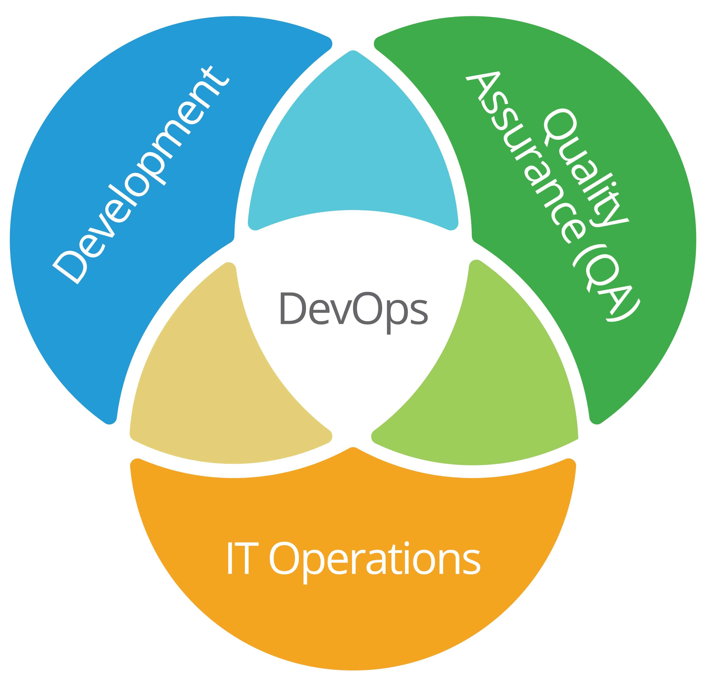
The Goal of DevOps
De-siloize the three areas involved in software development
To get everyone using the same sorts of tools, practices and automation processes
Operations infrastructure is now IaC
  The same processes are used to manage both application code and infrastructure code
Allows for integration of the processes used in development with operations
  Able to respond to real time feedback on how the applications running in the Ops environment

Slide 15
Defining CI/CD
CI/CD is not a methodology
  Continuous Integration / Continuous Delivery (Deployment)
  It is not Agile or DevOps, although both rely on and use it extensively
CI/CD is a process automation applied to software engineering
  Not a development or process methodology
  Similar to other kinds of automation
  Improves process efficiency and effectiveness
CI/CD is process agnostic
  Can be used anywhere a software engineering process is well defined
  Using CI/CD with bad processes makes them worse
A fool with a tool is still a fool
Martin Fowler
A computer lets you make more mistakes faster than any invention in human history – with the possible exceptions of handguns and tequila
Mitch Ratcliffe

Slide 16
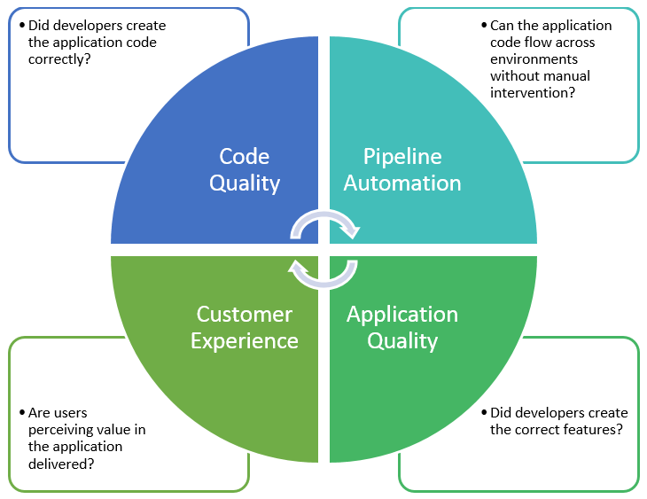
Continuous Testing
Does not replace human based testing
  Techniques like pair programming and code reviews are still critical to software QA
Automated testing can now be built into the entire development and operations cycle
Creates “quality gates”
  These are automated tests that must pass for the pipeline to continue
  Development pipelines abort when tests fail
  Identifies problems early in production so they can be remediated sooner
  Adding continuous security testing and security planning is called DevSecOps

Slide 17
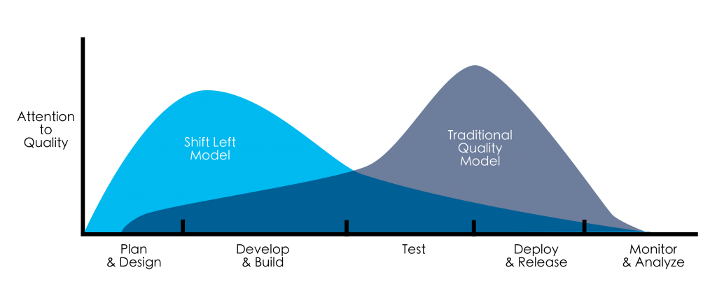
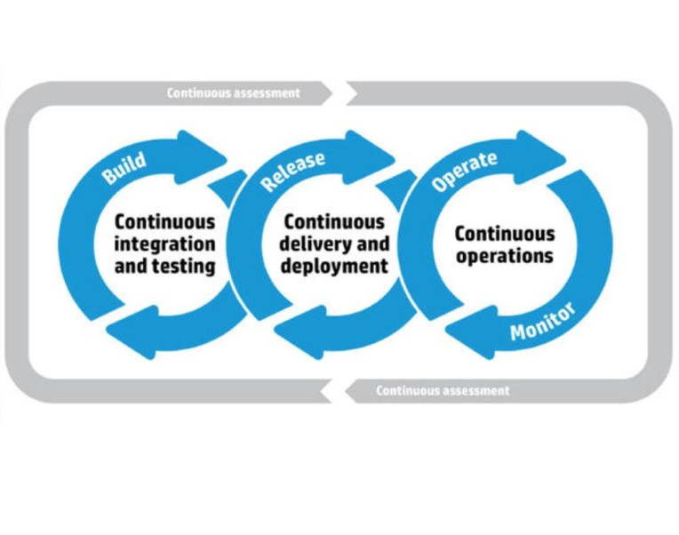
Continuous Testing
Continuous Testing
  Every artifact is tested as it is created
  Shift Left Model
  Test early, test often
CI/CD also adds
  Automated testing at every stage
CT is triggered by events in the CI/CD process
  Checking in code => automated unit testing
  Build => integration testing

Slide 18
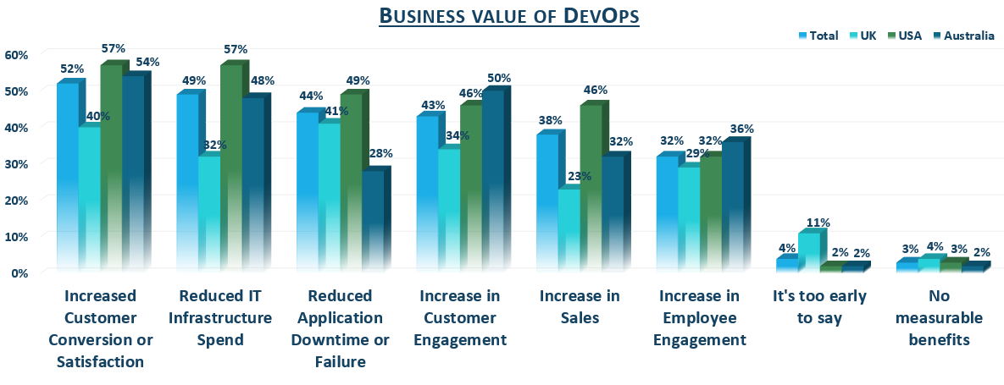
DevOps Cost Benefit

Slide 19
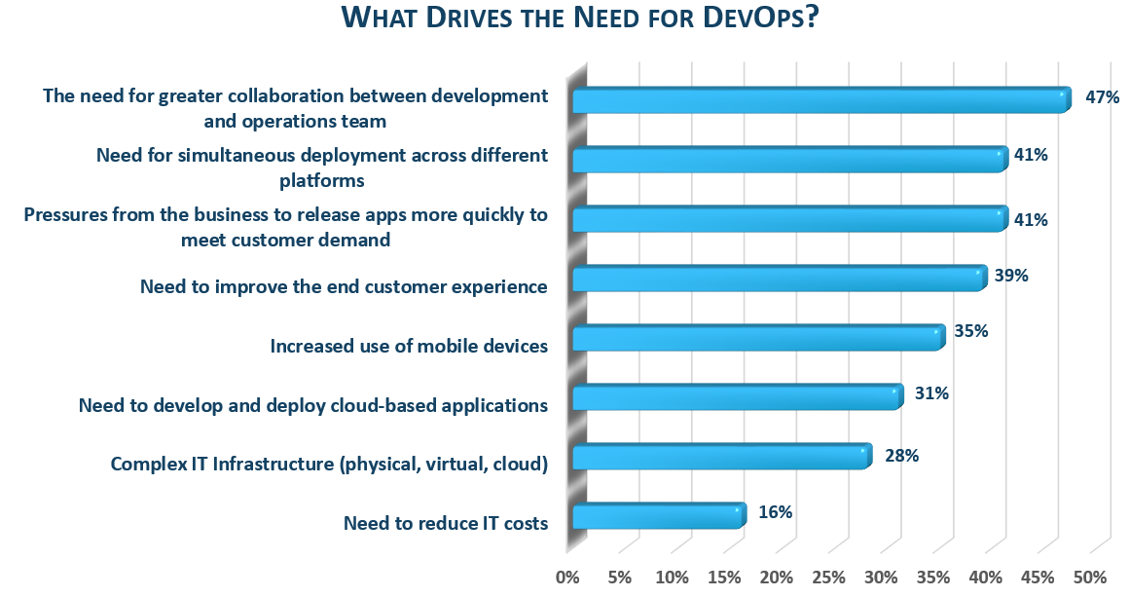
DevOps Cost Benefit

Slide 20
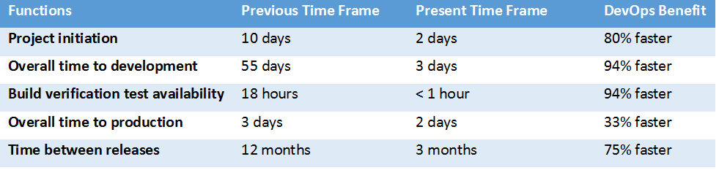
DevOps Cost Benefit
DevOps, clearly an extension of lean and agile principles, was as much, in IBM, born of necessity to respond to a pervasive industry mandate to “do more with less” and has evolved to “quality software faster.”
- Kristof Kloeckner,
General Manager,
IBM Software Group – Rational
https://www.compaid.co.in/Articles/DevOps-Value-and-Cost-Savings

Slide 21
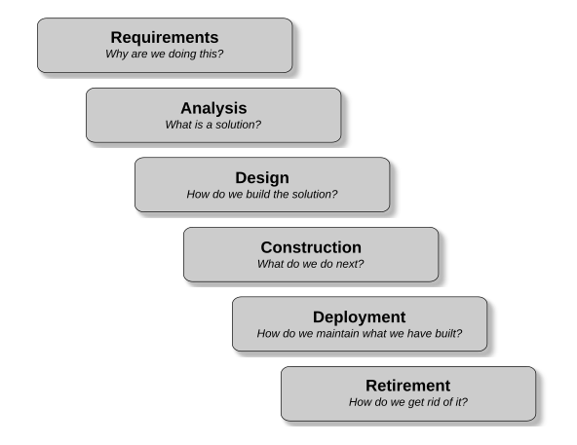
The Engineering Cycle
The Engineering Cycle
  A set of logical steps that are needed whenever we build something or deliver a service
    Each step builds on the previous one
    How we apply this cycle is a “process type”
Waterfall process types
  Completes each step in the process fully before moving on to the next step
    Also called a “predictive” process because given the full set of requirements and technical constraints, we can accurately predict what the final product will should be
    Common in engineering systems and high risk systems like nuclear reactor control software or airline navigation software
    Or where requirements and technology don’t change over the lifetime of the project, like building a bridge for example

Slide 22
In Real Life
For a lot of application areas, the waterfall doesn’t work
  There is often too much uncertainty and variation at each stage of the engineering cycle
  Results in a lot of re-work as we respond to variance, unplanned changes or newly discovered facts in any of the engineering cycle stages
These problems are not just software related
  They are common across a variety of industries
Various alternatives to the waterfall approach were experimented with in multiple industries
  Collectively, these are referred to as adaptive methodologies
  They continuously adapt the engineering process and stages to accommodate uncertainty and variance during the project
    Essentially incorporating risk management into a production process
  Most notable of these is Scrum

Slide 23
Scrum
Scrum was not originally designed for software development
  It was originally developed for industrial manufacturing in the 1950s-1980s
  Major influences on Scrum were “Lean manufacturing” and the Toyota production system
In the 1980s, there was a major crisis in software development
  It was being developed in a big-bang approach using waterfall methodologies
  Siloed teams (design, development, testing) with one-time hand offs of artifacts
However, this problem had been identified decades earlier
  For example, NATO software engineering conference in 1968 was held to address the high failure rate of these big-bang projects
    The conclusion of this and other similar conferences was that an incremental and iterative approach, like Kaizen (continuous improvement) and lean approaches to product development were needed
    They were looking to the adaptive methodologies used in manufacturing as a possible model for software development

Slide 24
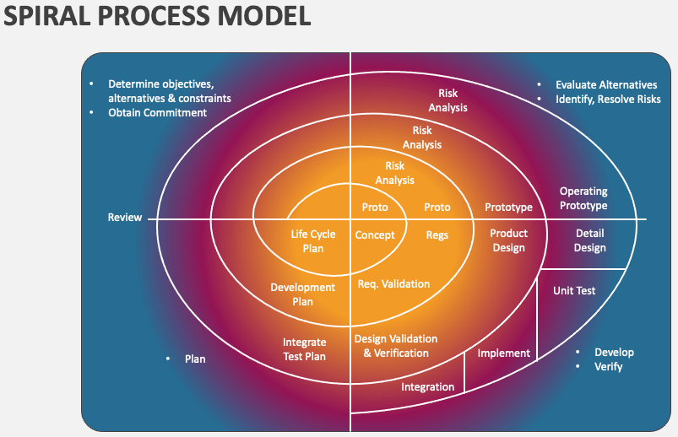
Scrum
In the 1980s and 1990s
  Companies experimented with using what they called adaptive software development
  IBM, DuPont, and others experimented with iterative prototyping and empirical process control like the Spiral methodology
Characterized by
  Use of successive prototypes to get feedback on requirements, design and performance
  Short iterations (one month or less)
  Cross-functional teams
  Daily meetings for synchronization
  A prioritized feature list
Image Credit: https://www.collidu.com/presentation-spiral-process-model

Slide 25
Frameworks and Methodologies
A common mistake is to consider Scrum an Agile methodology
  It is not a methodology, it is a process framework
  Failure to have a methodology defined while using Scrum negates the value of using it
Scrum is process-focused
  Scrum focuses on how to organize the team and the work and manage the process
Agile methodologies are practice-focused
  Managing how the actual development work is done at the code and design levels
The two complement each other
  Scrum without a software engineering methodology risks low quality software being built
  A software engineering methodology without Scrum risks lack of direction and effectiveness

Slide 26
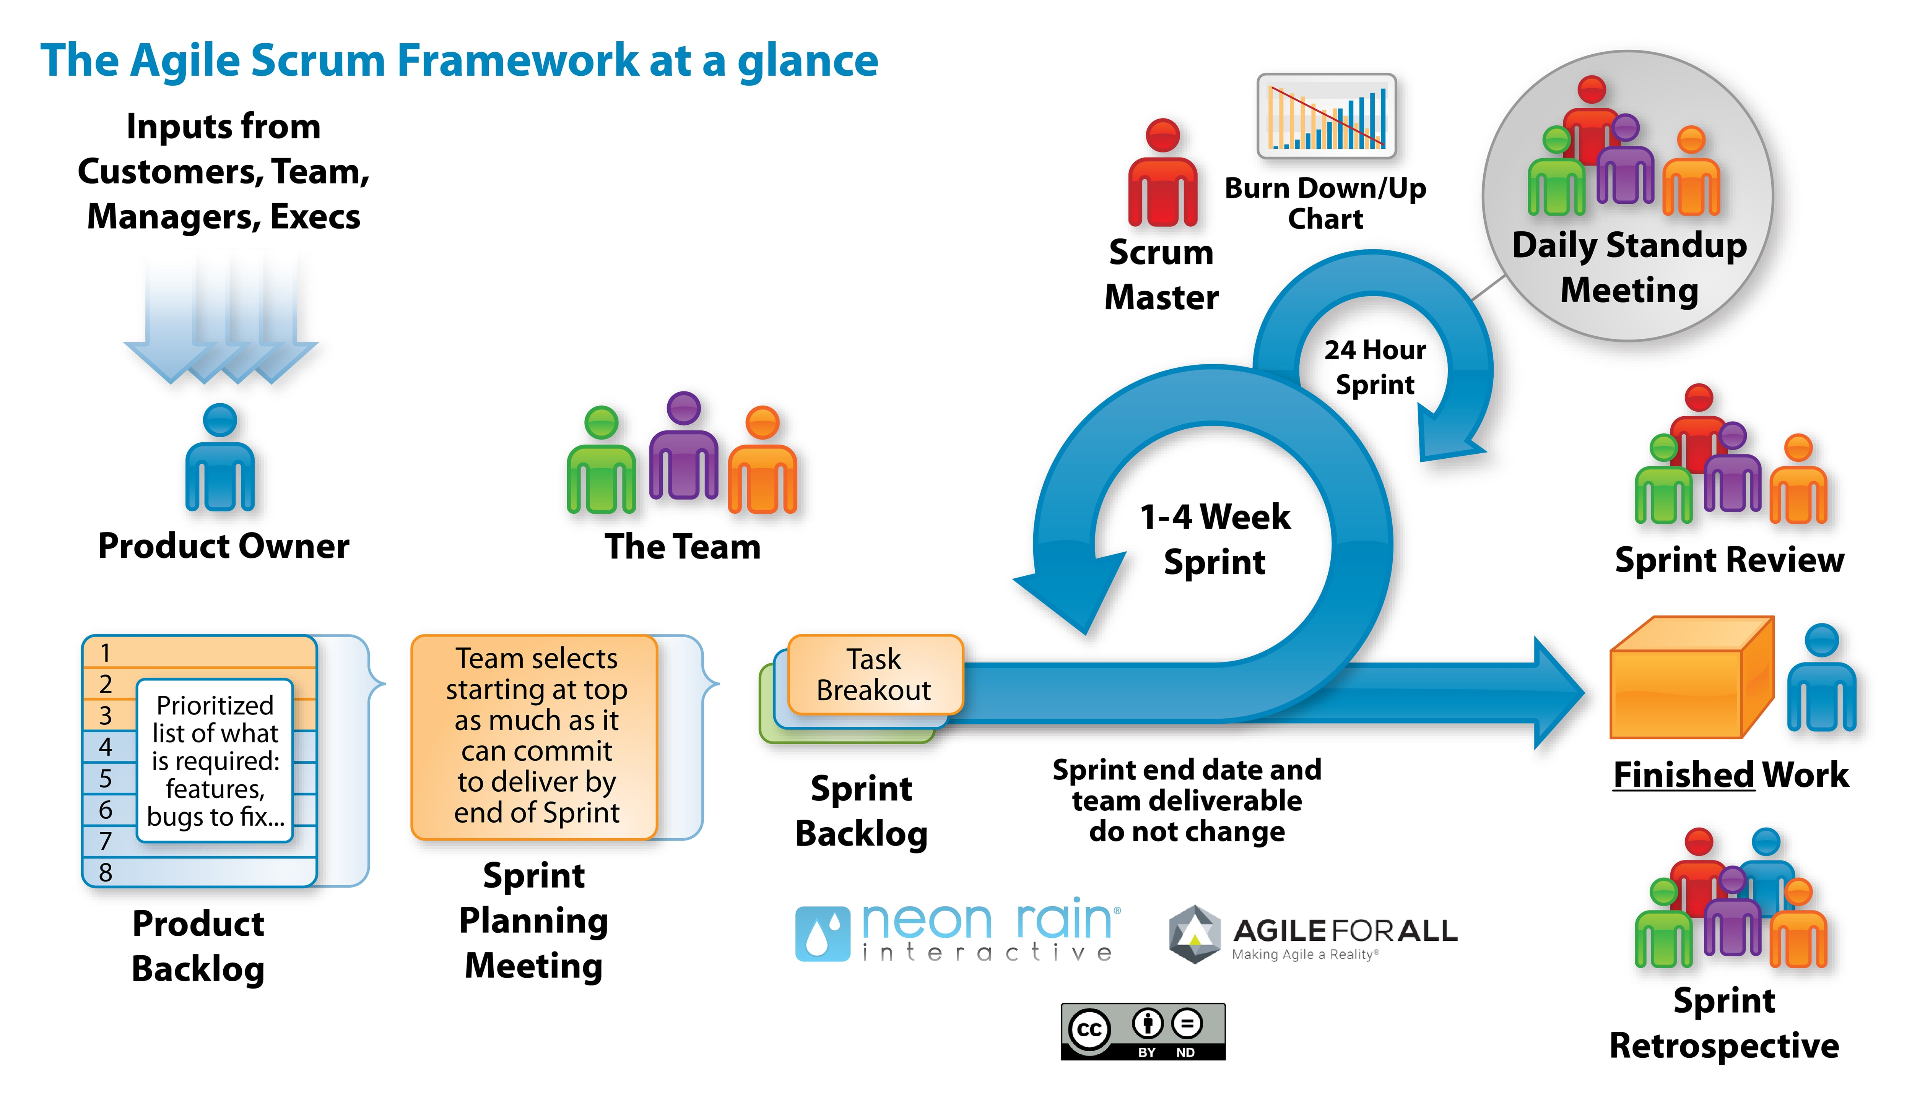
Scrum at a Glance

Slide 27
Scrum and Agile
The term “Agile” was adopted in 2001
  Defined by owners of adaptive methodologies that shared a similar approach to development
  Derived many of their ideas from their use of Scrum ideas in their methodologies
    For example: Extreme Programming, Feature Driven Development
Many of the features of Scrum form the foundation of the Agile Manifesto and the Agile Principles
  Note that Scrum is NOT an Agile methodology, but its concepts were shared among Agile methodologies and were highly influential
  Specifically:
    Individuals and interactions
    Working software prototypes
    Customer collaboration and feedback loops
    Responding to change in a planned systematic way

Slide 28
Extreme Programming (XP)
Example of an Agile methodology
Developed in the late 1990s by Kent Beck
  One of the original Agile methodologies
  Designed to improve software quality and responsiveness to changing customer requirements through frequent releases, continuous feedback, and disciplined technical practices
Core ideas
  XP focuses on adaptability, collaboration, and technical excellence
  Pushes core agile principles to the “extreme”
  Ensuring that teams can deliver value rapidly and sustainably even in high-uncertainty environments
  Very dependent on automation, typical of most Agile methodologies
    For example, automated unit testing, automated builds, integration testing and refactoring

Slide 29
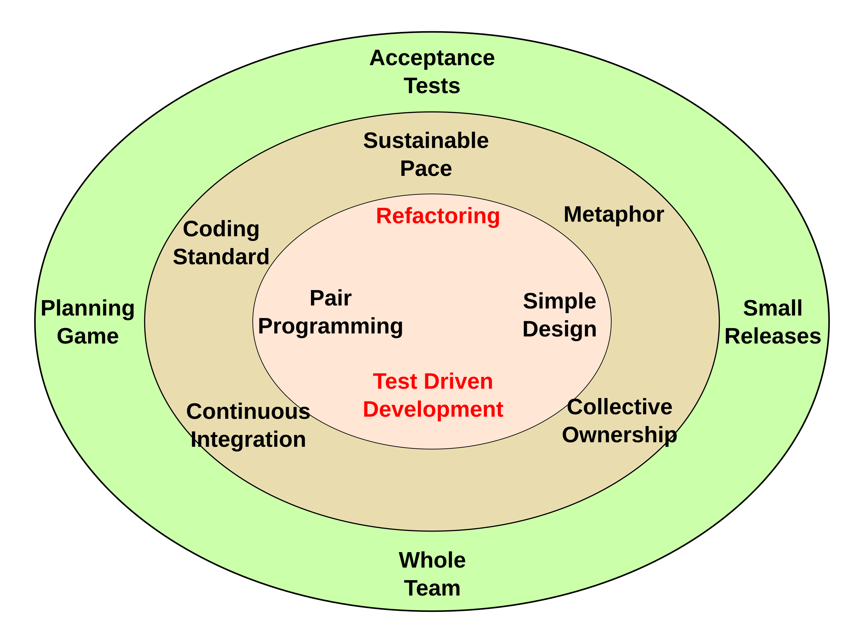
Extreme Programming (XP)

Slide 30
Extreme Programming (XP)
Key characteristics:
  Highly iterative and incremental: frequent releases and feedback loops
  Human-centered: collaboration and trust are central
  Quality-driven: testing, integration, and refactoring prevent defects
  Adaptable: embraces change as part of the process, not a disruption
But to meet these goals, automation is essential
  Automated unit testing
  Automated build management
  Automated deployments
  Automated feedback from prototypes

Slide 31
Three Drivers of CI/CD
The need to develop and deploy large numbers of microservice components
  These needed to be done via an automated development pipeline
  Traditional app development wasn’t getting the job done
  Mission critical nature of the components required built-in quality control and testing
The need to automate a number of phases of Agile development
  Working prototypes need be regularly produced with short turnaround times
  Continuous testing during development to reduce rework
Infrastructure as code
  IaC code is now needed to define the environment for building application code
  The same sort of development requirements as app code now apply to operations and IaC

Slide 32
Benefits of CI/CD
Smaller code changes
  Simpler (more atomic) and have fewer unintended consequences
Mean time to resolution (MTTR) is shorter
  Smaller code changes and quicker fault isolation
Testability improves due to smaller, specific changes
  These smaller changes allow more accurate positive and negative tests
Elapsed time to detect and correct production issues is shorter
The backlog of non-critical defects is lower
  Defects are often fixed before other feature pressures arise
The product improves rapidly through fast feature introduction and fast turn-around on feature changes

Slide 33
Benefits of CI/CD
CI/CD product feature velocity is high
  The high velocity improves the time spent investigating and patching defects
Feature toggles and blue-green deployment strategies
  Enable seamless targeted introduction of new production features
Upgrades introduce smaller units of change and are less disruptive
End-user involvement and feedback during continuous development leads to usability improvements
  Can add new requirements based on customer’s needs on a regular basis

Slide 34
Challenges for CI/CD
Organization silos and corporate culture
  Lack of communication between development, QA and operations
Failure to automate testing or to do continuous testing
  QA starts lagging behind development requiring rework to fix buggy code
Legacy systems integration
  Automated tools may not be available for legacy systems
  E.g. Unit testing frameworks for COBOL code
Complexity and size of applications
  Trying to apply CI/CD to too big a “chunk” of development
  Especially when introducing CI/CD improvements

Slide 35
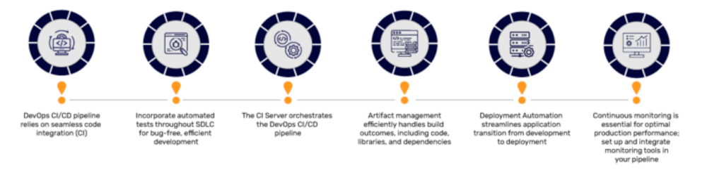
Pipelines
A pipeline is a series of automated steps that take a software component from coding all the way to the operational environment
Image Credit: https://www.mindbowser.com/devops-ci-cd-pipeline-stages/

Slide 36
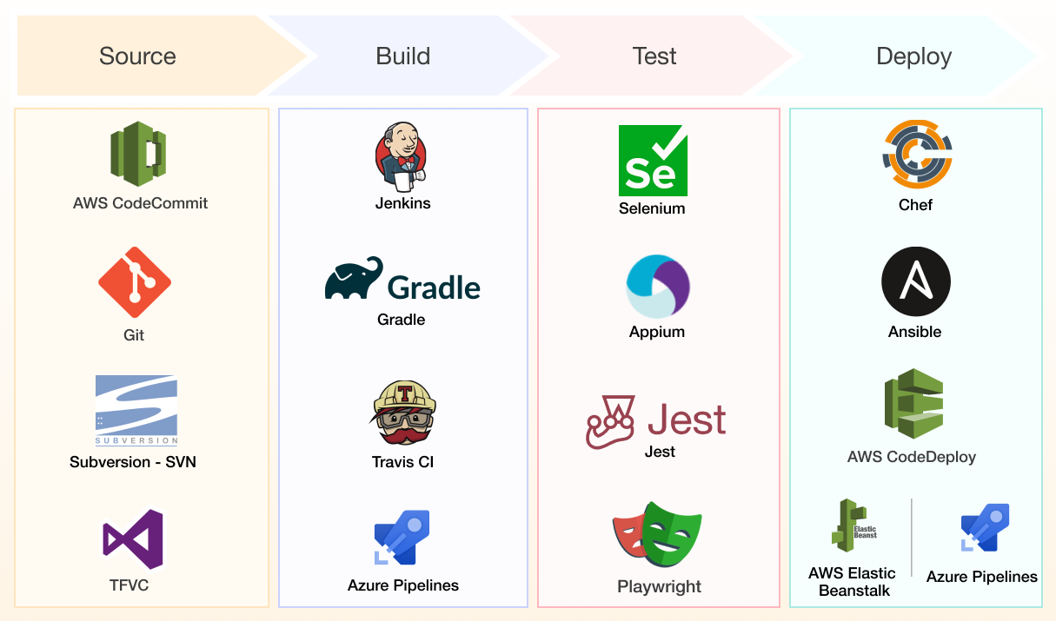
Automation Tools Drive Stages
Image Credit: https://www.simform.com/blog/scalable-ci-cd-pipeline-examples/

Slide 37
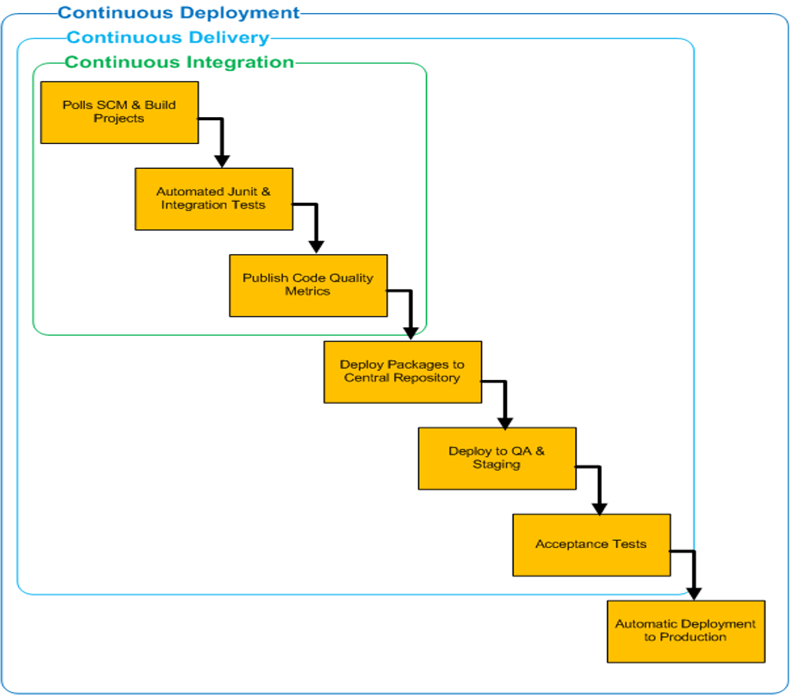
Continuous Integration, Delivery and Deployment

Slide 38
Continuous Integration (CI)
CI is the stage where members of a team integrate their work frequently
  Usually each person integrates at least daily, leading to multiple builds per day
Each integration is verified by an automated build
  Automated builds that are successful trigger automated integration testing
    Intended to detect integration errors as quickly as possible
    Goal is to merge and test the code continuously to catch issues early by automating the integration process
A CI project must have a reliable, repeatable, and automated build process involving no human intervention
  CI Server (orchestration tool) is responsible for performing the integration tasks
  Automatic unit testing, static analysis and failing fast are core to CI

Slide 39
Continuous Integration Practices
Single source repository for all developers
Build automation
  Every change to the integration branch should trigger a new build
  Keep the builds fast and trackable
  Make the builds self-testing
Test the builds in production-like environment
  Keep all verified releases in artifacts repository and available to everyone
Publish coding metrics

Slide 40
Continuous Delivery (CD)
CD is a natural extension of CI
  Every change to the system that has passed all the relevant automated tests should be ready to deploy in production
  Team should be able to release any version “at the push of a button”
  Keeps all verified releases in artifacts repository and available to everyone
But the deployment into the production environment is not automatic
  The goal of CD is to put business owners in the control of scheduling of the software releases
  The decision to release is a governance decision, not a technical one
  Users are notified the release is available but it is deployed only with the user’s approval

Slide 41
Continuous Deployment (also CD)
Continuous Deployment adds automatic deployment to end users in the Continuous Delivery process
  Continuous Deployment automatically deploys every successful build directly into production
  Deploying the build to production as soon as it passes the automated and UAT tests
Continuous Deployment is not appropriate for many business scenarios
  Business Owners prefer more predictable release cycles as opposed to arbitrary deployments

Slide 42
CI/CD as a General Pipeline Pattern
A pipeline is an automated, ordered set of stages that transform an input artifact into a validated, deployable output
This idea shows up everywhere:
  Software delivery (CI/CD)
  Data engineering (ETL/ELT)
  Machine learning (MLOps)
  Infrastructure (IaC pipelines)

Slide 43
CI/CD Pipelines (Baseline Reference)
Source → Build → Test → Package → Deploy → Monitor
Example tools
  GitHub Actions / GitLab CI / Jenkins
  Maven / Gradle / npm
  Docker / Helm
  Kubernetes / VM / PaaS

Slide 44
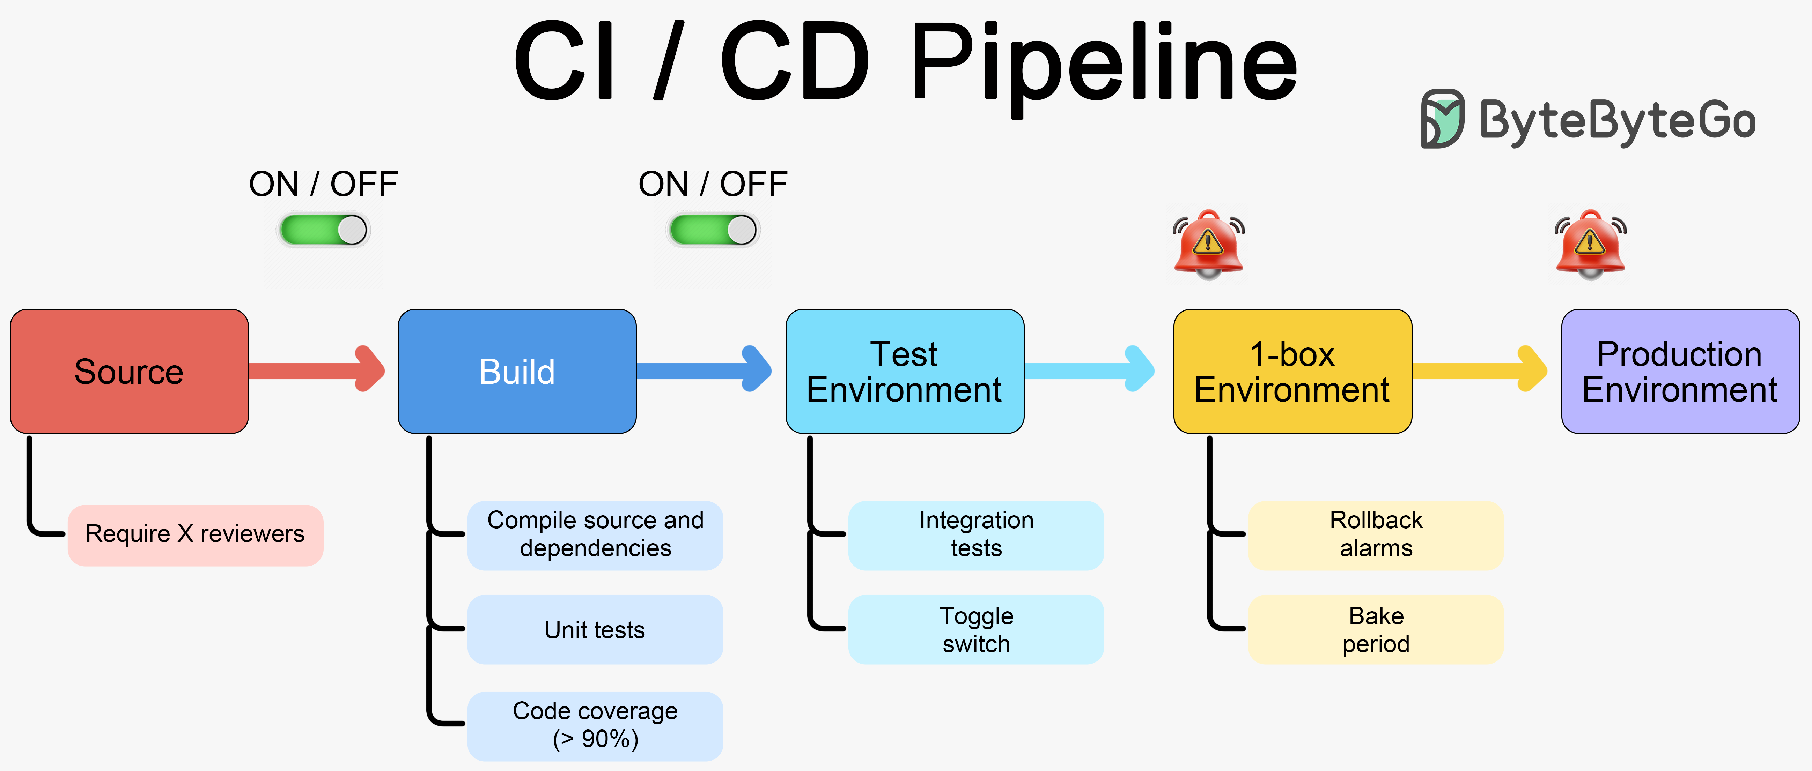
CI/CD Pipelines (Baseline Reference)
Image Credit: https://blog.bytebytego.com/p/a-crash-course-in-cicd

Slide 45
Data Pipelines (Data Engineering)
Ingest → Validate → Transform → Load → Quality Check → Publish
  Data pipelines apply the same CI/CD logic, but the “artifact” is data, not code
Example tools
  Source: Kafka topic / API / database
  Transform: Spark / Flink / dbt
  Load: Data warehouse (BigQuery, Snowflake)
  Validation: Great Expectations
  Orchestration: Airflow / Dagster
CI/CD benefits
  Versioned SQL and transformation logic
  Automated schema validation
  Test datasets before production loads
  Promotion of pipelines from dev into prod

Slide 46
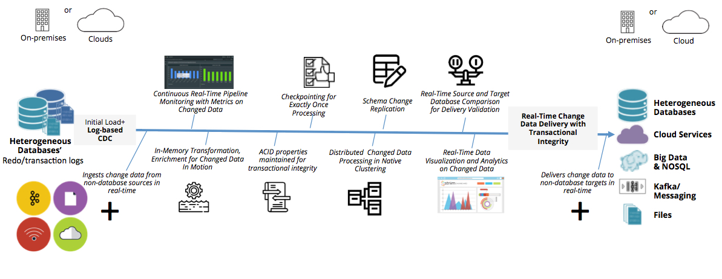
Data Pipelines (Data Engineering)
Image Credit: https://www.striim.com/blog/what-is-a-data-pipeline-and-must-have-features-of-modern-data-pipelines/

Slide 47
MLOps Pipelines (Machine Learning)
Data → Feature Engineering → Train → Evaluate → Register → Deploy → Monitor
  MLOps pipelines extend CI/CD to building, training and developing machine learning models
Example tools
  Training: TensorFlow / PyTorch
  Tracking: MLflow
  Model Registry: MLflow / SageMaker
  Deployment: REST endpoint / batch job
  Monitoring: Drift detection, accuracy decay

Slide 48
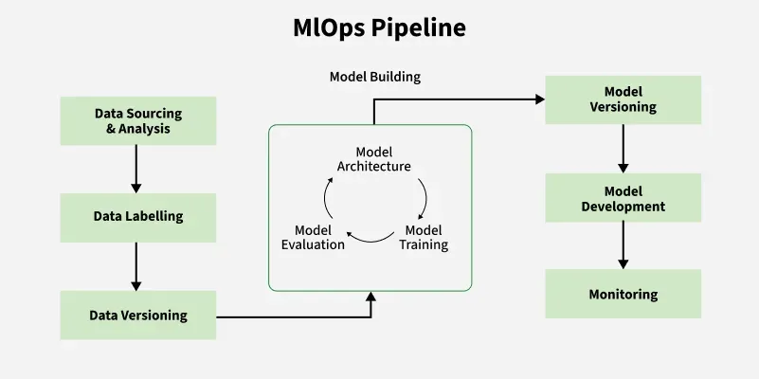
MLOps Pipelines (Machine Learning)
Image Credit: https://www.geeksforgeeks.org/machine-learning/mlops-pipeline-implementing-efficient-machine-learning-operations/

Slide 49
Infrastructure Pipelines (IaC)
Define → Validate → Plan → Apply → Verify
  Infrastructure is treated as a versioned artifact, validated and promoted like code
Example tools
  Terraform / Pulumi
  Automated security scans
  Environment promotion (dev → test → prod)

Slide 50
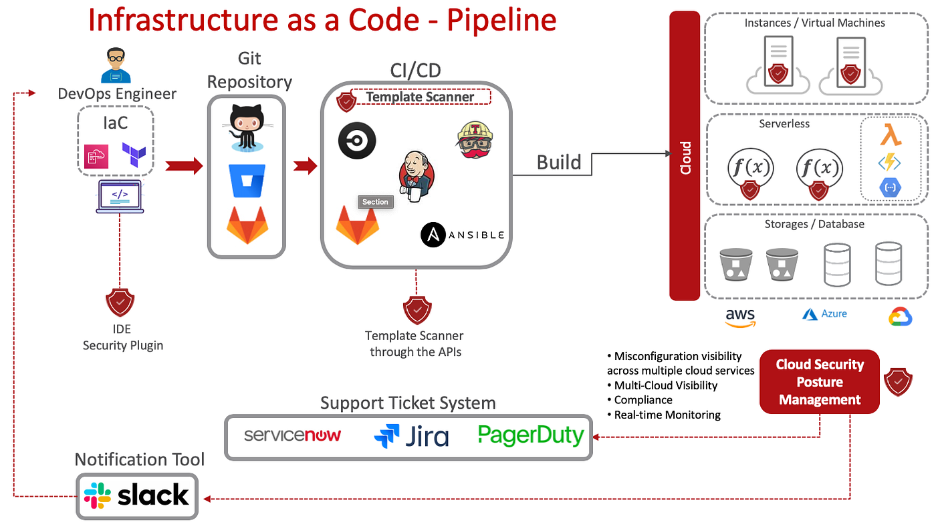
Infrastructure Pipelines (IaC)
Image Credit: https://medium.com/swlh/putting-security-into-the-iac-pipeline-4de98f88ad24

Slide 51
Tool Chains
Generally some form of repository tool is used for the CI environment
  Usually git based like GitHub or GitLab
Various packaging and build tools are used throughout the process
  These are generally dependent on the programming development environments
  For Java, we usually see Maven and Gradle for example
Automated testing tools are used throughout the pipeline
  Unit testing, Cucumber/Behave integration testing
  Code quality tools like SonarQube
The whole process is managed by an orchestration tool
  Commonly Jenkins is used as a standalone tool
  GitLab and GitHub have orchestration capabilities that are often used

Slide 52
Questions

